Slide 1
Sparrow Reproduction
JenRaMa

Slide 2
Problem Overview
Sparrow addresses the problem of executing many tasks in distributed systems.
Two major approaches to scheduling
Centralized
Globally-optimal
High-latency placement
Better for many large tasks
Decentralized
Locally-optimal
Low-latency placement
Better for many small tasks

Slide 3
Technical Solution
Sparrow proposes a decentralized scheduler that uses randomization.
Key aspects:
batch sampling
scheduler sends d*m probes (d = 2, m = #tasks)
late binding
when probes reach the head of the queue, the tasks are assigned there

Slide 4
Implementation Plan
Minimal Viable Project
Implement Sparrow, and other scheduling techniques for comparison
Sparrow-style scheduling (batch + late binding) should outperform other scheduling techniques (main result of paper)
Stretch Goals
Fault-tolerance (worker failures)
More than two user priority levels
Preemption for higher-priority tasks
Comparison to Spark on an additional (more complex) synthetic workload
Adversarial schedulers

Slide 5
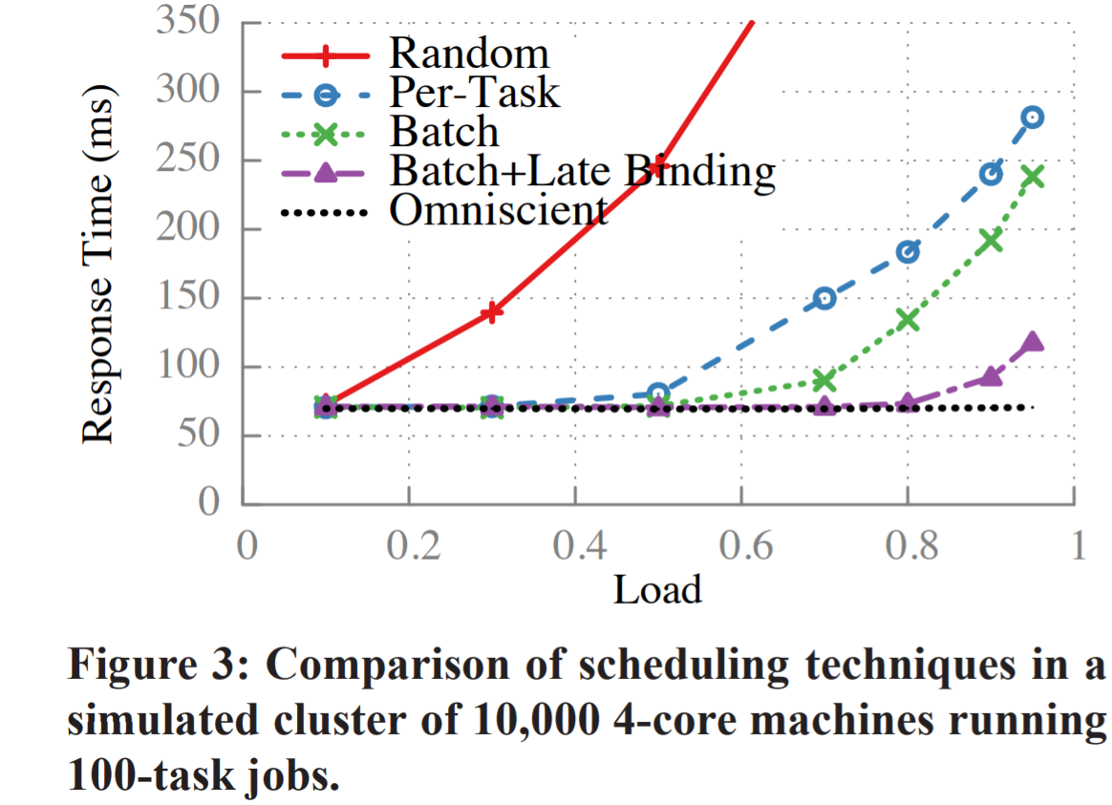
Evaluation Plan
Most important graph from paper (MVP)

